Slide 1

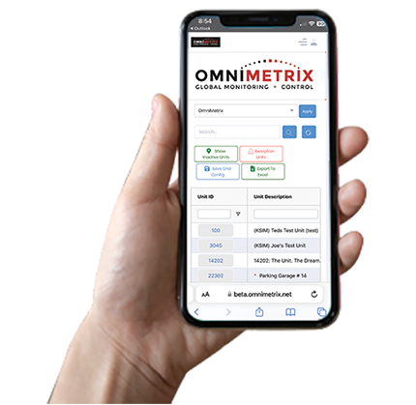

Acorn Energy, Inc. - Nasdaq: ACFN
Growing Base of Recurring, High Margin
Remote Monitoring & Control Revenue
September, 2025 www.acornenergy.com

Slide 2
Non-GAAP Financial Measures
Safe Harbor Statement
This presentation includes forward-looking statements, which are subject to risks and uncertainties. There is no assurance that the Company will be successful in growing its businesses; in reaching profitability; growing through acquisition; or in maximizing the value of OmniMetrix or any other of its assets. The Company has a history of operating losses and there is no assurance that it can attain and maintain profitability. This presentation includes projections regarding expected performance by OmniMetrix and the Company generally which are based on management’s good faith estimates as to future performance and should not be taken as a guarantee of such performance. A complete discussion of the risks and uncertainties which may affect Acorn Energy and the businesses of its OmniMetrix subsidiary is included in “Item 1A. Risk Factors” in the Company’s most recent Annual Report on Form 10-K as filed by the Company with the Securities and Exchange Commission.
This presentation includes both GAAP and Non-GAAAP financial and performance measures. The Company uses Enterprise Value as a measure of the value of the Company’s business; it is calculated as the total market capitalization of the Company (common stock trading price multiplied by the shares outstanding less Cash). The Company uses EBITDA as a measure of performance; it is calculated as Net Loss plus Interest, Taxes, Depreciation and Amortization.
The non-GAAP financial measure used herein should be evaluated in conjunction with, and are not a substitute for, the GAAP financial information included in the financial statements filed by the Company with the Securities and Exchange Commission.

Slide 3

Wireless Remote Monitoring & Control
Acorn owns 99% of OmniMetrix which pioneered remote monitoring & control products/services for generators & gas pipelines
High-margin monitoring + hardware sales = 70%+ gross margin
Target 20% revenue growth in large underpenetrated markets
Operating leverage brings ~50% of incremental revenue to income/EBIT
Industry-leading “agnostic” technology/service delivers strong ROI
Value proposition grows as personnel/travel costs & regulations rise
Longer term, enabling ‘Demand Response’ electric Grid Relief from generators could double profitability on new monitoring contracts

Slide 4
At a Glance
Nasdaq ACFN
Recent Price $30.00
52-Week Range $8.75 - $33.50
Market Cap $75.0M
Less: Cash (as of August) $ 3.4M
= Enterprise Value (EV) $71.6M
LTM Revenue Through June $13.2M
2026 Target Rev (~20% growth) $15.8M
EV / Target Revenue 4.5x
Public IoT Comp Valuation Average (1) 5x
Public comps (ADT, ALRM, BMI, DGII, GNRC, AIOT, PSIX & IOT) with lower ARR% and gross margins trade at avg. EV/LTM revenue multiple of 5x. OSSIF acquired Q4’24 for ~9.9x revenue.
Insider Ownership ~35% of 2.5M shares.

Slide 5

Cellphone Provider Customer
Secured largest contract in OmniMetrix history with leading cellphone provider
$5.4M for monitoring devices & first year of monitoring
services for cell tower backup generators across U.S.
Recorded $4.1M in revenue through 1H 2025
  Balance of hardware sales expected in 2025;
  monitoring services continue into 2026
  Monitoring revenue expected to recur into future
Selection via rigorous competitive process confirms
value and strength of industry-leading solution.
Award puts OmniMetrix in strong position
for follow-on work and other large-scale deployments

Slide 6
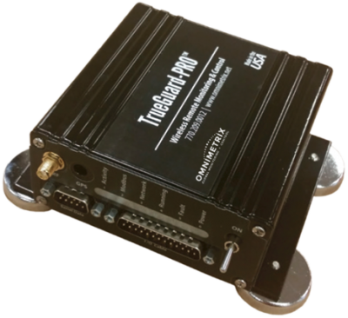
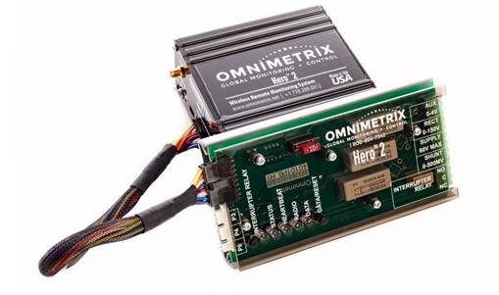
Wireless, Real-Time Monitoring
and Control of Industrial Equipment
Standby Generator &
Compressor Monitoring
Pipeline Cathodic Protection
Commercial/Industrial &
Residential Monitors
Rectifier & Test Station Monitors
Replaces manual inspection
Prevents fail to start events
Generator status anywhere 24/7
Secure, web-based management
Can remotely start generator
Enables Grid Demand Response
24/7 monitoring extends pipeline life
Instant alarm notifications
Eliminates remote manual data collection and inspection
Leverages cellular/satellite coverage
Notes:
OmniMetrix offers remote monitors for cathodic protection with the data points you need and a service team you can trust. With LTE and satellite communication options, you’ll always have the information you need on technology that will last longer than any monitoring alternative on the market.

Slide 7
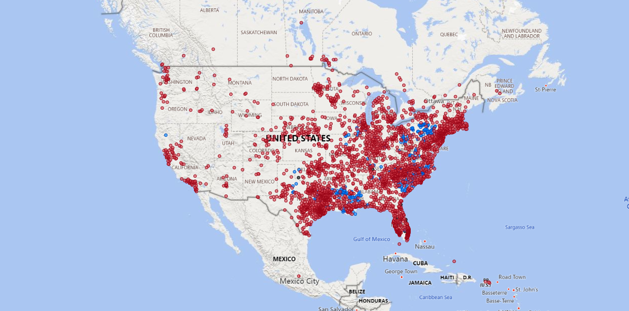

OmniMetrix Monitoring Footprint

Slide 8
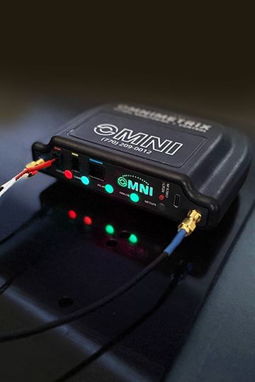
Next Generation Solutions
INTRODUCING OMNI & OMNIPRO:
Standby Generator Solutions
Sleek, modern, future-proofed design for flexibility, ease of installation ––– and a smaller footprint than prior TrueGuard versions.
Powerful processing speed for over air updates & a USBC Port on each unit. The OMNI also comes with plug-in wires vs. hardwiring that can be easily replaced or moved, even to another generator/brand.
Multi-color LEDs provide real-time status updates on the unit itself.
OMNI replaces TrueGuard for next generation residential monitoring with 50 alarms & 50 parameters available including: Battery Voltage, Fuel Level, Coolant Status, Missed Exercise/ Alarms & more.
OMNIPRO replaces TrueGuard Pro for next generation commercial applications with up to 1,000 alarms & parameters.
8

Slide 9
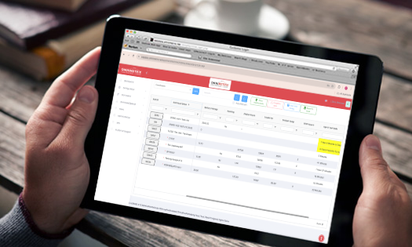
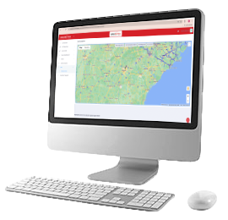
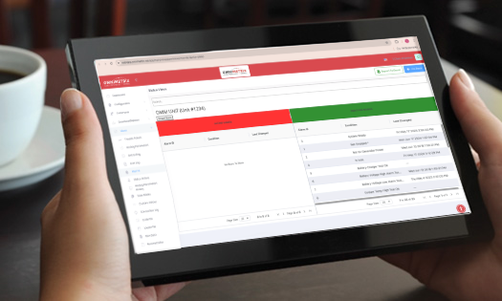



OMNIVIEW
User Interface
• See all monitors in one location
• Customizable home dashboard
• Email & text notifications for what you care about
• Schedule exercises or start/stop your generator from anywhere
• Compliance reporting to meet local, state & federal requirements
• Air Quality Index integration
• Multifactor Authentication for extra security
• All-new OmniView App available for Apple & Android devices
GET ALL OF YOUR MONITORING DATA IN ONE PLACE
COMPLIANCE REPORTING TO MEET LOCAL, STATE & FEDERAL REQUIREMENTS
8

Slide 10
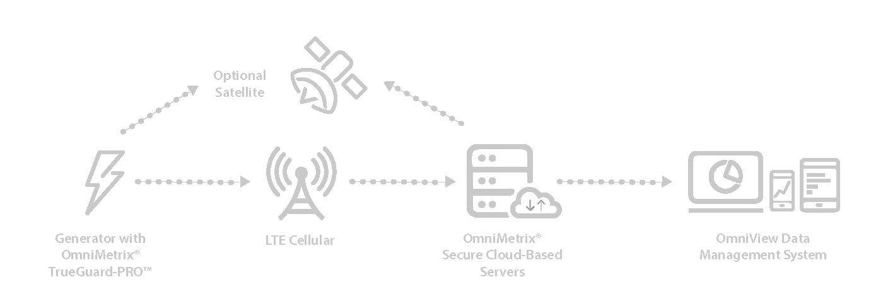
Remote Monitoring Value-Add
Reduces critical asset downtime; improves maintenance results
Prevents 95% of generator “fail to start” events’ by tracking/reporting
vitals: Battery - Voltage - Fuel - Coolant - Oil
Less expensive & more effective than labor & travel of regular physical inspection – particularly with widespread remote assets.
Generator Monitoring Illustration
9

Slide 11
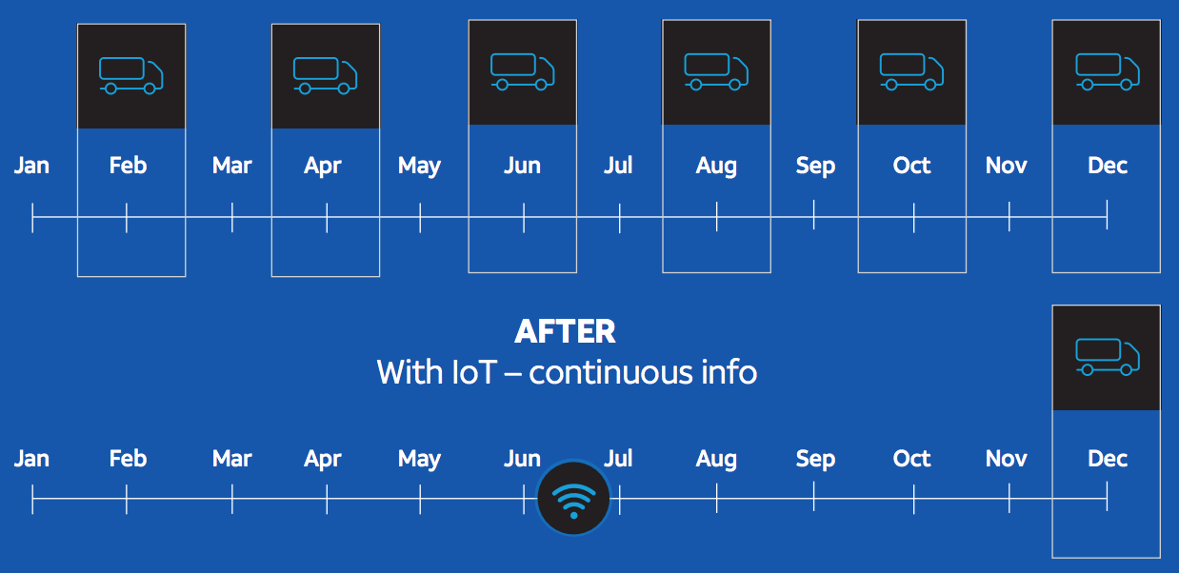
Remote Monitoring is Clean & Green
Reduces travel-related emissions, costs and time.
Pipeline inspectors travel long distances every 2 months to visually inspect pipeline & equipment for damage & to comply with regulations.
Remote monitoring delivers 24/7 information.
Average on-site generator inspections cost $250-$400 per site and find 10% of generators in need of service.
Provides data/insights to fine tune operations, drive efficiency and safety.

Slide 12












Diverse Markets & Customer Base
>25 Fortune 500 Companies Use OmniMetrix Solutions
  Oil & gas, utilities
  Aerospace & defense
  Industrial, healthcare
  Telecommunications
  Insurance/Financial
  Real estate
  Hospitality, chemicals
  Retail, Grocery
  Banks (100+)
  Transportation
  Consumer Products
  Federal, state, local gov. US & Canada
    Military
    20+ police departments
    15+ fire departments

Slide 13




Growth Drivers
Management targets 20% average annual revenue growth
Clear ROI from lower costs and improved asset monitoring & control
Growing awareness of monitoring benefits/ROI amidst rising costs
  With 4.2M generators and 10% in need of service, remote monitoring
  creates maintenance revenue for generator dealers
Regulatory compliance and reporting:
  US EPA, Air Quality Management Districts, National Fire
  Protection Assoc. & Calif. EPA Air Resources Board
  Reporting: Maintenance, Location, Fuel Status, Usage & Emissions
Delayed infrastructure investments increase monitoring need
  Approx. 2.5M miles of U.S. gas pipeline (>50%) are over 50 years old;
  Small % of these assets are monitored remotely
Expanding customer & partner base
Ongoing Product, technology & service enhancements
Electric Grid Demand Response - turning on generators to meet peak power
New market opportunities to monitor other industrial assets

Slide 14
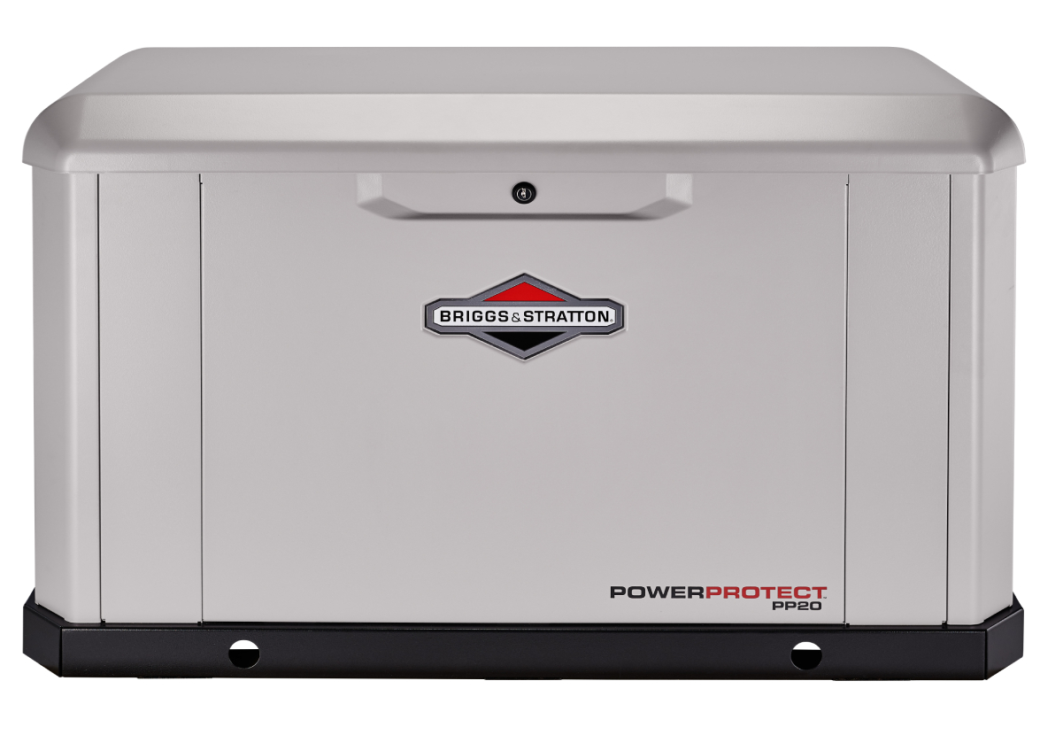
Stand-by Generator Market Opportunity
~4.2M generators in North America (growing by 300k+ per year);
Growing number of power outage incidents drives awareness & need:
  Rapidly rising electricity demand challenges grid reliability
  70% of power outages caused by weather events
  Stronger storms + higher frequency of floods, droughts,
  wildfires and other severe weather events
  Distributed work environments expand need for reliable power
Wildfires and energy grid issues are creating new market opportunity estimated as much of 50% of total generator replacement market, or $1B over 10 years
OmniMetrix is widely considered the strongest remote monitoring solution
  Dealers often prefer OmniMetrix due to features, quality, service, ease of installation and compatibility with all generator brands
  Commercial & industrial businesses appreciate platform strength, capabilities and ability to support all generators

Slide 15
Demand Response Opportunity
Partnership with CPower Energy Management enabling standby generator owners to provide electric grid relief via “Demand Response” (DR) programs.
  CPower manages ~6.7 GW of demand response capacity at 27,000+ US sites
  OmniMetrix’s wireless solutions activate and monitor generator activity in partnership with CPower’s national energy provider network.
DR compensates users who allow their generator to be automatically switched on to support the grid during peak demand.
  Potential to double OmniMetrix’ profit per customer on each new DR customer.
DR incentivizes deployments of next-generation, energy efficient standby generator equipment required for DR participation.
  DR revenue streams benefit all participants:
  Customers, dealers, energy providers and program enablers such as Omni.
It is taking time for grid operators and others to solidify the long-term business model to support a larger scale roll out DR support from standby generators.
  Revenue from OmniMetrix’s small DR customer base remains modest

Slide 16
Competitive Barriers
27 Years of Industry Technology Leadership, Expertise and Customer Success:
    OmniMetrix pioneered remote generator monitoring
    Engineering, software development, trade secrets, industry reputation, etc.
Next-Generation Solutions:
    Ongoing R&D to enhance solutions, expand capabilities and target new markets
Partnerships:
    CPower Demand Response Programs
    PowerNow with Briggs & Stratton Generator Deployments in Texas
Strong Patent Portfolio:
    #11101580: Cathodic protection testing apparatus/methods w/ relay & bypass circuitry (RAD)
    #8763107: Cross-connected, server-based, IP-connected, point-to-point connectivity
    #8224499: Remote annunciator
    #8078861: Remote processor reprogramming (critical for software updates)
    #6747368: Wireless control of power transfer switches for electrical load management
    #6571093: Methods for providing extended wireless data transport services

Slide 17
Historical Financial Performance
($ in thousands) | LTM | 2024 | 2023 | 2022 | 2021 | 2020
Total revenue* | $13,202 | $10,986 | $ 8,059 | $ 7,000 | $ 6,776 | $ 5,922
Gross profit | $9,708 | $7,999 | $ 6,004 | $ 5,071 | $ 4,899 | $ 4,131
Gross margin** | 73.5% | 72.8% | 74.5% | 72.4% | 72.3% | 69.8%
* All Acorn revenue is derived from its 99%-owned operating subsidiary, OmniMetrix.
** Gross margin varies depending on mix of high margin recurring monitoring revenue
and lower margin hardware sales revenue.

Slide 18
Summary Balance Sheet – 6/30/25
Cash & Equivalents $ 3.3M
Accounts Receivable $ 2.1M
Total Current Assets $ 6.8M
Total Assets $12.5M
Total Current Liabilities
excluding $3.2M in deferred revenue (1) $ 0.9M
Total Liabilities excluding $3.2M in current
& $0.5M in non-current deferred revenue (1) $ 1.9M
Tax Assets (2):
NOL Carryforwards (>$65M Gross NOL * 21% tax rate) ~ $14.0M
Deferred revenue represents hardware sales and monitoring services, which were recorded as revenue over 36-months and 12-months term, respectively. Hardware sales are no longer deferred, as they are now sold separately from monitoring services, which are still deferred and recorded to revenue over 12-months.
Acorn capitalized a portion of the NOL carryforward as a deferred tax asset by recording a deferred income tax benefit of $4.35M in Q4’24. The remaining tax assets (approx. $10M) are in reserve and reviewed periodically.

Slide 19
Leadership
Jan Loeb – Acorn President and CEO and Director; Acting CEO of OmniMetrix:
Jan has served as President and CEO of Acorn since Jan. 2016 and was appointed to the Board in August 2015. He was named acting CEO of OmniMetrix in Nov. 2019. Jan has 40+ years experience in investment banking, money management and public company management. He is President and Managing Member of Leap Tide Capital Management since 2007 and was President of Leap Tide's predecessor, AmTrust Capital Management 2005 to 2007. Prior, he was a Portfolio Manager at Chesapeake Partners; Managing Director at Jefferies & Company and Managing Director at Wasserstein Perella. Jan is a former Director of Keweenaw Land Association, Ltd., TAT Technologies and American Pacific Corporation.
Tracy Clifford – Acorn CFO and COO of OmniMetrix:
Tracy Clifford was named Chief Financial Officer of Acorn in June 2018 and was named COO of OmniMetrix in Nov. 2019. Tracy previously served as CFO, Principal Accounting Officer, Corporate Controller and Secretary for a publicly-traded pharmaceutical company and a publicly-traded REIT from 1999 to 2015. Through her consulting practice launched in June 2015, Tracy served as a contract CFO and/or COO for several clients, participated on advisory boards and worked on numerous engagements. Prior experience included accounting leadership positions at United Healthcare (Atlanta) and the North Broward Hospital District (Fort Lauderdale) and work on the audit team of Deloitte & Touche (Miami).

Slide 20
Investment Summary
ACFN trades for 4.5x its 2026 Revenue Target vs. average IIoT comps (with lower gross margins) trading at an average of 5x, despite:
  Growing, recurring, high margin revenue model and large market opportunity
    $5.4M cellphone provider contract confirms ACFN leadership & expands monitoring base
    ~50% of incremental revenue is expected to fall to Operating Income
    ACFN generated $1.8M of cash from operating activities LTM through June 2025.
    Rapidly rising electricity demand combined with increasing frequency of power outages is driving growing adoption of back-up generators and remote monitoring
Technology, product & service leadership and differentiation
    Solid track record of innovation and new product launches
Large customer base including >25 Fortune 500 companies
Zero debt and $3.4M in cash (Aug 2025) supports organic & M&A growth initiatives
Remaining NOL offers potential for $14m in future tax savings @ 21% tax rate
Disciplined management (35% ownership) with strong track record of value creation and prudent asset allocation

